Slide 1
PresEntation topic:
Polling technique
Outline:
    Definition
    Explaination
    Disadvantages
    Example
    Questions

Slide 2
Polling mechanism
Polling mechanism are used to handle events or condition in assembly language, particularly interacting with hardware device.
OR
CPU repeatedly check the status of a pheripheral device or a specific condition to see if it requires attention.

Slide 3
Explanation
This is commonly used in embedded systems and low level programming where direct interaction with hardware is required.
It’s a protocol.
Example:
The computer continuously checks whether the printer is ready to receive data and prints a document once the printer is ready.

Slide 4
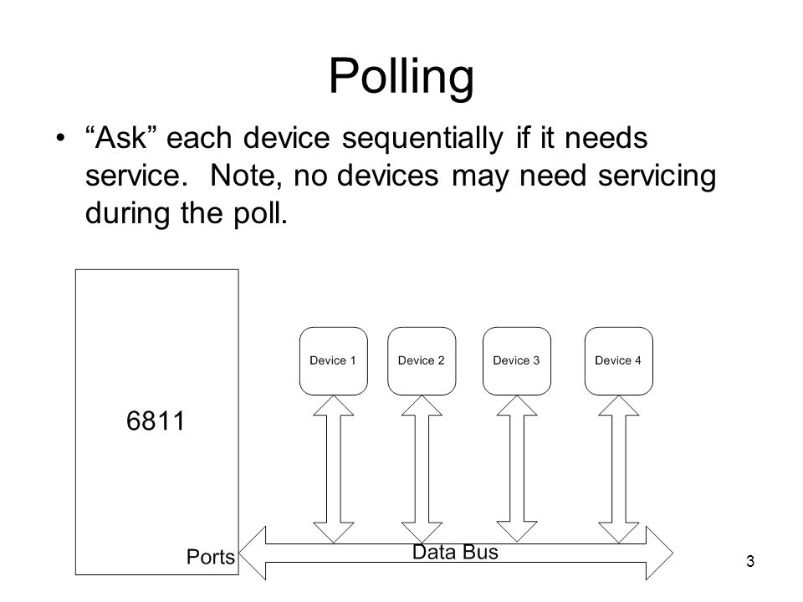

Slide 5
Disadvantage:
Wastes memory time
Busy Waiting
Poor Performance:

Slide 6
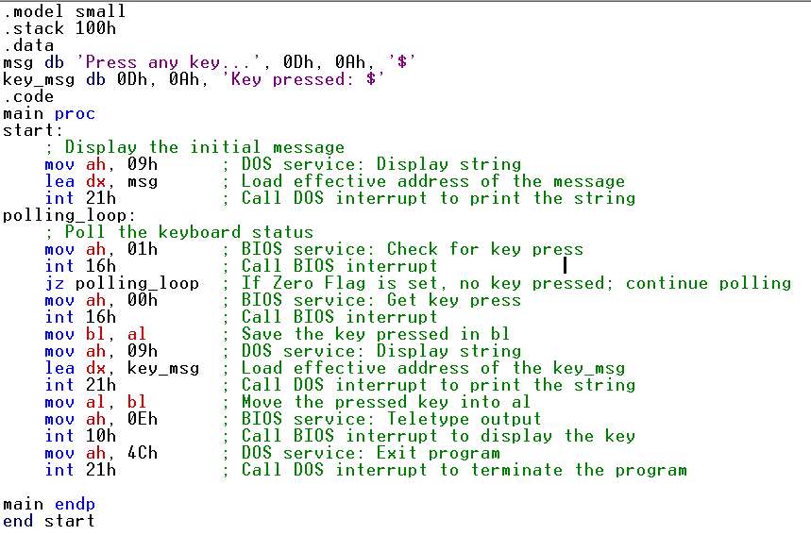
program

